Slide 1
VETERINARY PARASITOLOGY
THIRD YEAR STAGE
2018-2019
PROF. DR. GAHZI Y. AL-EMARAH
PARASITOLOGEST
Department of Veterinary Microbiology and Parasitology
College of Veterinary Medicine
University of Basrah

Slide 2
NEMATODA
Chabretia ovina
General Characteristics
- Occur in the colon.
- The host; sheep ,goat ,cattle and number of the ruminants throughout the world.
- The males are 13-14mm long and the females 17-20mm long.
The anterior end is curved slightly ventral and large buccal capsule opens anteroventrally.
- There are leaf-crown and a shallow ventral cervical groove.

Slide 3
NEMATODA
Chabretia ovina
General Characteristics
- The male bursa is well developed and the spicules are 1.3-1.7mm long.
- The eggs measure 90-105 by 50-55Mm.
Life Cycle
- Infection occurs per os by larvae relatively long tail.
- L3 undergo an extensive histotropic phase in the wall of the small intestine prior to the third ecdyses 7-8 days after infection.

Slide 4
NEMATODA
Chabretia ovina
Life Cycle
- Up to 26 days reach the colon.
- L4 develop mainly in the lumen of the caecum.
- The fourth ecdyses occurs on average about 24 days after infection.
- P.P is 49 days.

Slide 5
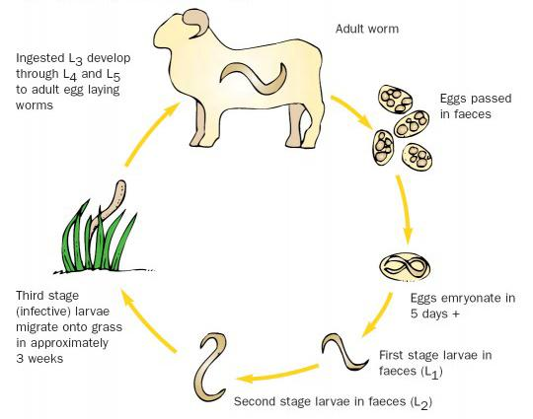
NEMATODA
Life Cycle of Chabretia ovina

Slide 6
NEMATODA
Chabretia ovina
Pathogenicity and Pathogenesis
1- The granular layer which is digested by the secretion of the oesophageal glands of the worm.
2- Worms suck blood.
3- An increased activity of goblet cells and infiltration with lymphocytes and eosinophils.

Slide 7
NEMATODA
Chabretia ovina
Clinical Signs
1- Diarrhoea with much blood and mucus.
2- Lose condition and become anaemic and die.
Diagnosis
- Clinical signs.
- Faecal culture .
- Serological exam.
Treatment
Rx and benzimidazoles.

Slide 8
NEMATODA
FAMILY: ANCYLOSTOMATOIDEA
General Characteristics
- The buccal capsule bears on its ventral margin 1-4 pairs of teeth.
- The dorsal gutter dose not project into the cavity of the buccal cavity to form a dorsal cone.

Slide 9
NEMATODA
Ancylostoma caninum
General Characteristics
- Occure in the small intestine.
- The host; dog, fox , wolf and other wild carnivores .rarely in man.
- It’s cosmopolitan in distribution, being common in tropical and sub tropical zones in north Amerce ,Australia and Asia.
- The male is 10-12mm long and the female 14-16mm long.

Slide 10
NEMATODA
Ancylostoma caninum
General Characteristics
- The worms are fairly rigid and gray or reddish in colour, depending on the presence of the blood in the alimentary canal.
- The anterior end is bent dorsal and the oral aperture is the directed anterodorsally .
- The buccal capsule is deep.

Slide 11
NEMATODA
Ancylostoma caninum
General Characteristics
-There are bears three teeth on either side of the buccal capsule (in the depth of the capsule there is a pair of triangular dorsal teeth a pair of centrolateral teeth).
-The male bursa is well developed and the spicules are 0.8-0.95mm long.
- The vulva is situated near the junction of the second and last thirds the body .
.

Slide 12
NEMATODA
Ancylostoma caninum
General Characteristics
- The eggs measure 56-75 by 34-47Mm and contain about eight cells when passed in the faeces.

Slide 13
NEMATODA
Ancylostoma caninum
Life Cycle
Adult female produce 16000 eggs per day.
The pre-infection stages are none resistant to desiccation , so that they are found only in moist surrounding.
-The optimal temperature for development is between 23 and 30ºc.
A variety of developmental pathways may occur following infection.

Slide 14
NEMATODA
Ancylostoma caninum
Life Cycle
1- Oral infection
May be the larvae are placed in the mouth a preparation will penetrate the buccal and pharyngeal epithelia and undergo migration as skin penetration .
2- Skin penetration
Leads to migration to the lungs and by tracheal migration to the intestine (somatic migration).
3- Prenatal infection

Slide 15
NEMATODA
Ancylostoma caninum
Life Cycle
4- Colostral or lactogenic infection
- The larvae after enter the host reach blood vessels or lymphatic vessel and are carried by these via the venous system or thoracic duct to the heart and lungs
- larvae pass into the alveoli and migrate up the bronchioles ,bronchi and trachea and are then swallowed and mature in the small intestine .
- P.P is 17 days.

Slide 16
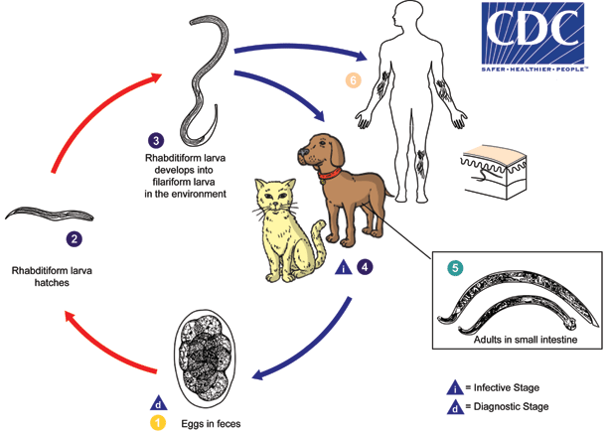
NEMATODA
Life Cycle of Ancylostoma caninum

Slide 17
NEMATODA
Ancylostoma caninum
Pathogenicity and Pathogenesis
1- Anaemia
2- Worms suck blood due to poor source of iron in blood and milk .
3- An increased activity of goblet cells and infiltration with lymphocytes and eosinophils.
4- The animals are more able to cope with the blood lose, which could be at a rate of as much as one –quarter of the total circulating erythrocyte volume.

Slide 18
NEMATODA
Ancylostoma caninum
Clinical Signs
1- Diarrhoea with much blood and mucus.
2- The dog lose condition and become anaemic and die.
3- Oedema ,general weakness and emaciation
4- The coat becomes harsh and dry .
5- The chief clinical signs is anaemia.
Diagnosis
- Clinical signs.
- Faecal culture .

Slide 19
NEMATODA
Ancylostoma caninum
Diagnosis
- Serological exam.
Treatment
Rx, Tetrachloroethylene, Bephenium compounds and Mebendazole.

Slide 20
THANK YOU

